Slide 1
AUTOMATED CONTROL SYSTEMS
LOAD-CARRIED CRANES
Checked by Bogach N.V.
Written by Baraev Damir

Slide 2
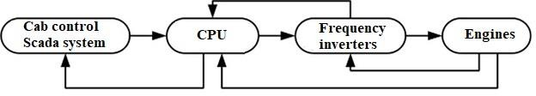
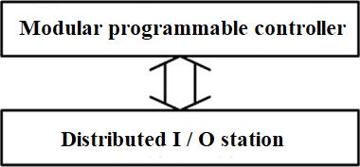

BASIC CONCEPT
In general, the automated control system of the modern crane is presented below:
The control cabin is an automated crane operator's place intended for the supply of control signals by means of special joysticks to the central processor, as well as for monitoring technical characteristics and technological parameters of the process with the help of a SCADA system (Simatic WinCC is used as a SCADA system software).
The SCADA system implements a different set of functions:
visualization function
archiving of all variables
technological, emergency events
cents about the operation of the crane for the selected period or about the state of the individual subsystem for a certain period of time
The central processing unit (CPU) is shown below:
2

Slide 3
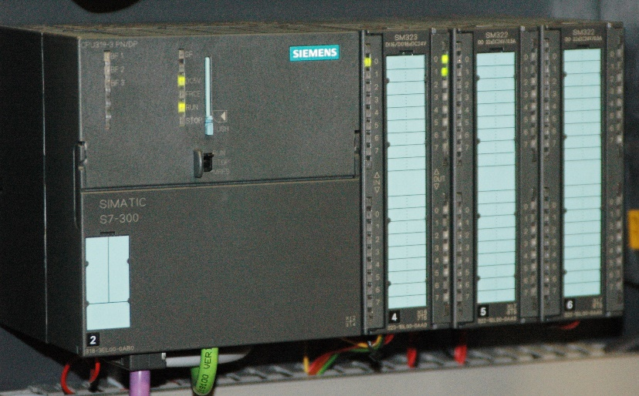
CONTROLLER DESCRIPTION
Most often as a program controller, the Simatic S7-300/400 modular controllers are used in conjunction with distributed I / O stations. Controllers have a modular structure and include the following components:
CPU module.
Power supply modules that provide power to the controller from an alternating current network with a voltage of 120 / 230V or from a 24/48/60 / 110V DC source.
Signal modules for input and output of discrete and analog signals.
Communication processors, for connection to the PROFIBUS network.
Functional modules capable of independently solving the tasks of automatic control.
Interface modules, which provide the possibility of connection to the base unit of expansion racks.
Simatic S7-300
3

Slide 4
FREQUENCY CONVERTER DESCRIPTION
The block of frequency converters is designed for smooth adjustment of the speed of short-circuited lifting motors, movement of the crane, etc. in the entire range of its variation by changing the frequency of the motor supply voltage.
The frequency converter is connected to the programmable controller by hardware using the PROFIBUS process bus and programmatically by assigning an address to the corresponding module. This connection involves blocking the operation of the control system in the presence of an error in any of the frequency drives.
Advantages of using the frequency converters in combination with a programmable controller:
Improved positioning accuracy due to low minimum speed.
Reduced mechanical impacts due to smooth start and stop:
The possibility of using both a nominal minimum speed and a nominal speed limit.
Reduction of brake wear due to electric braking.
Increase the productivity of the crane.
The ability to program both separately and simultaneously an hourly
4

Slide 5
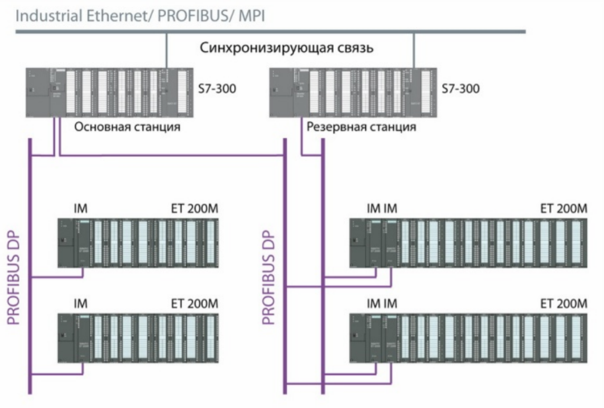
FREQUENCY CONVERTER DESCRIPTION
When programming the control system of the crane, high-level languages S7GRAPH are used.
The main principle of software backup is that part of the program is loaded both into the main controller and to the backup one. While the CPU of the main controller processes this part of the program, the CPU of the backup controller misses it. This prevents the discrepancy between the two program parts.
Redundant systems
5

Slide 6
CONCLUSION
Thus, classical control methods are used for a completely deterministic control object and a deterministic environment, and for fuzzy information systems and highly complex control objects, fuzzy control methods are optimal. At the same time, the integrator, which is the link between the two methods, is implemented as a software controller and fully "answers" not only for the interaction of methods among themselves, but also for prioritizing autonomous methods for solving the management problem. In the architecture of integrated hybrid systems, the integrator module plays a major role and, depending on the current conditions for finding the solution and the target, selects the various program modules included in the system for operation.
6

